Slide 1
Graphs
Copyright © McGraw-Hill Education. All rights reserved. No reproduction or distribution without the prior written consent of McGraw-Hill Education.

Slide 2
Outline
Introduction
Basic Graph Terminology
Digraphs and Relations
Representation of Graphs
Operation on Graphs
Paths and Circuits
Graph traversals
Shortest Path in Weighted Graphs
Eulerian paths and Circuits
Hamiltonian Paths and Circuits
The travelling salesman Problem-Nearest Neighbor Method
Planar Graphs

Slide 3
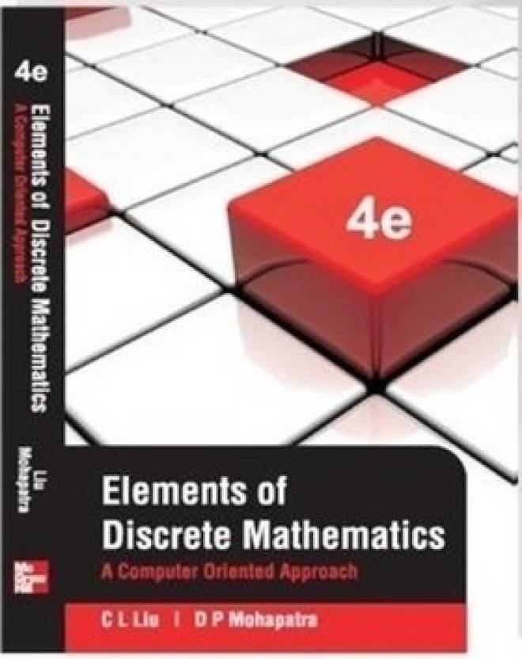
Topics for Self Study
Multigraphs and Weighted Graphs(Elements of Discrete Mathematics, C.L Liu and D.P Mohapatra, 4e)
Factors of a Graph(Elements of Discrete Mathematics, C.L Liu and D.P Mohapatra, 4e)
Graph Coloring(Elements of Discrete Mathematics, C.L Liu and D.P Mohapatra, 4e)

Slide 4
Introduction and Motivation
To model a computer network where we care about the number of links between data centers, we use a multigraph.
To model a computer network with diagnostic links at data centers, we use a pseudograph, as loops are needed.
To model a network with multiple one-way links, we use a directed multigraph. Note that we could use a directed graph without multiple edges if we only care whether there is at least one link from a data center to another data center.

Slide 5
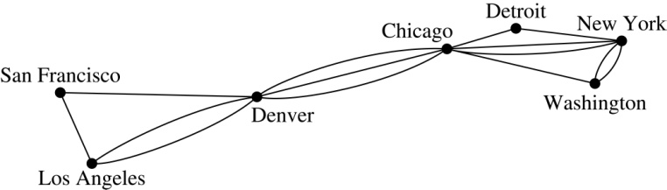
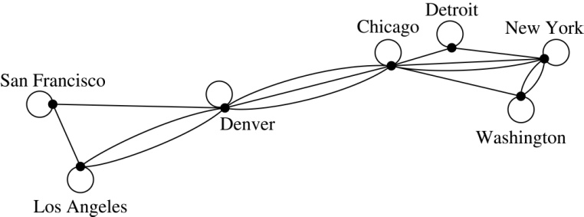
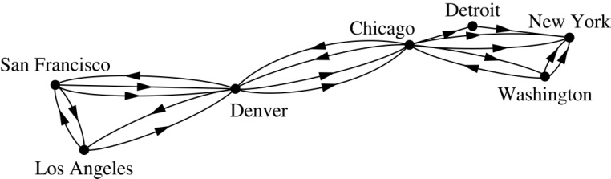
Graph Models: Computer Networks (continued)
.

Slide 6
Introduction and Motivation
We will illustrate how graph theory can be used in models of:
Social networks
Communications networks
Information networks
Software design
Transportation networks
Biological networks
It’s a challenge to find a subject to which graph theory has not yet been applied. Can you find an area without applications of graph theory?

Slide 7
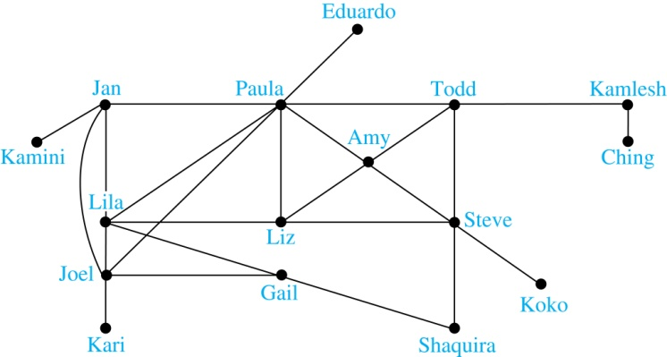
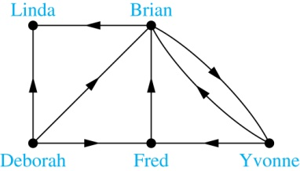
Introduction and Motivation
Example: A friendship graph where two people are connected if they are Facebook friends.
Example: An influence graph

Slide 8
Graph Terminology
Definition: A graph G = (V, E) consists of a nonempty set V of vertices (or nodes) and a set E of edges. Each edge has either one or two vertices associated with it, called its endpoints. An edge is said to connect its endpoints.
A graph with an infinite vertex set is called an infinite graph. A graph with a finite vertex set is called a finite graph. A graph with no vertex and no edge is a null graph.
Example:
a
b
This is a graph with four vertices and five edges.
d
c

Slide 9
Graph Terminology
In a simple graph each edge connects two different vertices and no two edges connect the same pair of vertices.
Multigraphs may have multiple edges connecting the same two vertices. When m different edges connect the vertices u and v, we say that {u,v} is an edge of multiplicity m.
An edge that connects a vertex to itself is called a loop.
A pseudograph may include loops, as well as multiple edges connecting the same pair of vertices.
Example:
This pseudograph has both multiple edges and a loop.
a
b
Remark: There is no standard terminology for graph theory. So, it is crucial that you understand the terminology being used whenever you read material about graphs.
c

Slide 10
Directed Graphs
Definition: A directed graph (or digraph) G = (V, E) consists of a nonempty set V of vertices (or nodes) and a set E of directed edges (or arcs). Each edge is associated with an ordered pair of vertices. The directed edge associated with the ordered pair (u,v) is said to start at u and end at v.
Remark:
Graphs where the end points of an edge are not ordered are said to be undirected graphs.

Slide 11
Some Terminology (continued)
A simple directed graph has no loops and no multiple edges.
A directed multigraph may have multiple directed edges. When there are m directed edges from the vertex u to the vertex v, we say that (u,v) is an edge of multiplicity m.
Example:
a
b
This is a directed graph with three vertices and four edges.
c
Example:
In this directed multigraph the multiplicity of (a,b) is 1 and the multiplicity of (b,c) is 2.
a
b
c

Slide 12

Basic Terminology
Definition 1. Two vertices u, v in an undirected graph G are called adjacent (or neighbors) in G if there is an edge e between u and v. Such an edge e is called incident with the vertices u and v and e is said to connect u and v.
Definition 2. The set of all neighbors of a vertex v of G = (V, E), denoted by N(v), is called the neighborhood of v. If A is a subset of V, we denote by N(A) the set of all vertices in G that are adjacent to at least one vertex in A. So,
Definition 3. The degree of a vertex in a undirected graph is the number of edges incident with it, except that a loop at a vertex contributes two to the degree of that vertex. The degree of the vertex v is denoted by deg(v).

Slide 13
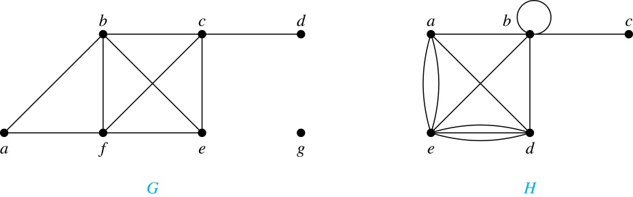
Degrees and Neighborhoods of Vertices
Example: What are the degrees and neighborhoods of the vertices in the graphs G and H?
Solution:
G: deg(a) = 2, deg(b) = deg(c) = deg(f ) = 4, deg(d ) = 1,
deg(e) = 3, deg(g) = 0.
N(a) = {b, f }, N(b) = {a, c, e, f }, N(c) = {b, d, e, f }, N(d) = {c},
N(e) = {b, c , f }, N(f) = {a, b, c, e}, N(g) = ∅ .
H: deg(a) = 4, deg(b) = deg(e) = 6, deg(c) = 1, deg(d) = 5.
N(a) = {b, d, e}, N(b) = {a, b, c, d, e}, N(c) = {b},
N(d) = {a, b, e}, N(e) = {a, b ,d}.

Slide 14
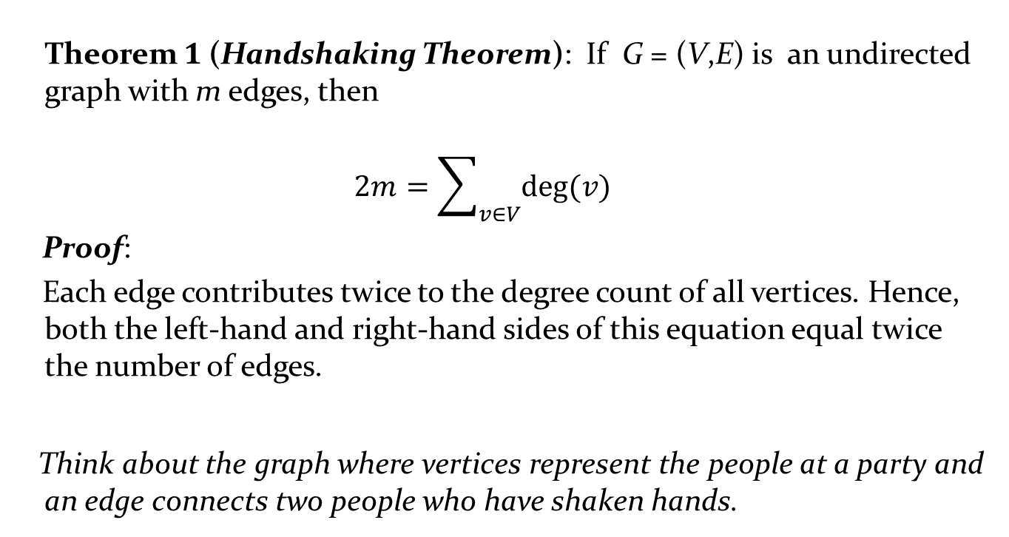
Degrees of Vertices
Theorem 1 (Handshaking Theorem): If G = (V,E) is an undirected graph with m edges, then
$$2m=\sum_{v∈V}{deg⁡(v)}$$
Proof:
Each edge contributes twice to the degree count of all vertices. Hence, both the left-hand and right-hand sides of this equation equal twice the number of edges.
Think about the graph where vertices represent the people at a party and an edge connects two people who have shaken hands.

Slide 15
Handshaking Theorem
We now give two examples illustrating the usefulness of the handshaking theorem.
Example: How many edges are there in a graph with 10 vertices of degree six?
Solution: Because the sum of the degrees of the vertices is 6 ⋅ 10 = 60, the handshaking theorem tells us that 2m = 60. So the number of edges m = 30.
Example: If a graph has 5 vertices, can each vertex have degree 3?
Solution: This is not possible by the handshaking thorem, because the sum of the degrees of the vertices 3 ⋅ 5 = 15 is odd.

Slide 16
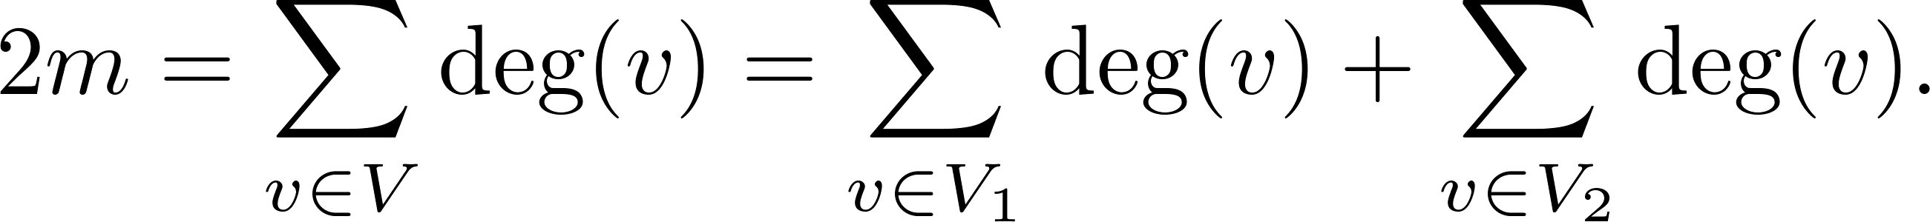
Degree of Vertices (continued)
Theorem 2: An undirected graph has an even number of vertices of odd degree.
Proof: Let V₁ be the vertices of even degree and V₂ be the vertices of odd degree in an undirected graph G = (V, E) with m edges. Then
even
This sum must be even because 2m is even and the sum of the degrees of the vertices of even degrees is also even. Because this is the sum of the degrees of all vertices of odd degree in the graph, there must be an even number of such vertices.
must be even since deg(v) is even for each v ∈ V₁

Slide 17
Directed Graphs and relations
Recall the definition of a directed graph.
Definition: An directed graph G = (V, E) consists of V, a nonempty set of vertices (or nodes), and E, a set of directed edges or arcs. Each edge is an ordered pair of vertices. The directed edge (u,v) is said to start at u and end at v.
Definition: Let (u,v) be an edge in G. Then u is the initial vertex of this edge and is adjacent to v and v is the terminal (or end) vertex of this edge and is adjacent from u. The initial and terminal vertices of a loop are the same.

Slide 18
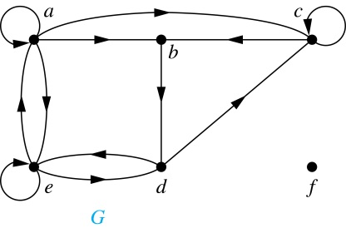
Directed Graphs (continued)
Definition: The in-degree of a vertex v, denoted deg⁻(v), is the number of edges which terminate at v. The out-degree of v, denoted deg⁺(v), is the number of edges with v as their initial vertex. Note that a loop at a vertex contributes 1 to both the in-degree and the out-degree of the vertex.
Example: In the graph G we have
deg⁻(a) = 2, deg⁻(b) = 2, deg⁻(c) = 3, deg⁻(d) = 2,
deg⁻(e) = 3, deg⁻(f) = 0.
deg⁺(a) = 4, deg⁺(b) = 1, deg⁺(c) = 2, deg⁺(d) = 2,
deg⁺ (e) = 3, deg⁺(f) = 0.

Slide 19
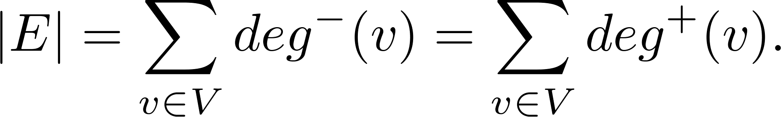
Directed Graphs (continued)
Theorem 3: Let G = (V, E) be a graph with directed edges. Then:
Proof: The first sum counts the number of outgoing edges over all vertices and the second sum counts the number of incoming edges over all vertices. It follows that both sums equal the number of edges in the graph.

Slide 20
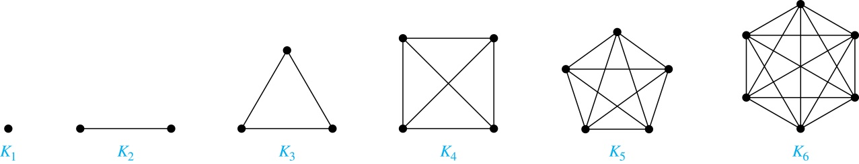
Special Types of Simple Graphs: Complete Graphs
A complete graph on n vertices, denoted by K_{n}, is the simple graph that contains exactly one edge between each pair of distinct vertices.
What are the number of edges in a complete graph of n vertices??

Slide 21
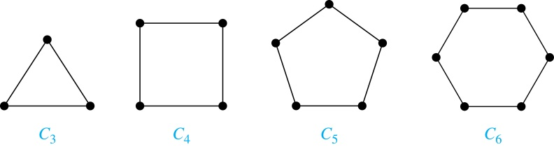
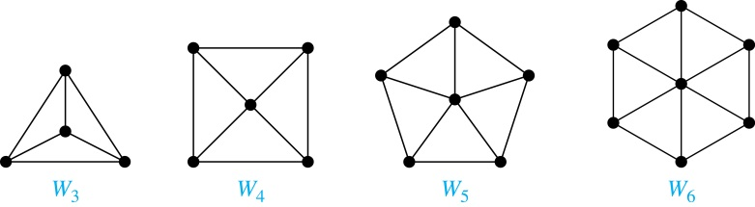
Special Types of Simple Graphs: Cycles and Wheels
A cycle C_{n} for n ≥ 3 consists of n vertices v₁, v₂ ,⋯ , v_{n}, and edges {v₁, v₂}, {v₂, v₃} ,⋯ , {v_{n-1}, v_{n}}, {v_{n}, v₁}.
A wheel W_{n} is obtained by adding an additional vertex to a cycle C_{n} for n ≥ 3 and connecting this new vertex to each of the n vertices in C_{n} by new edges.

Slide 22
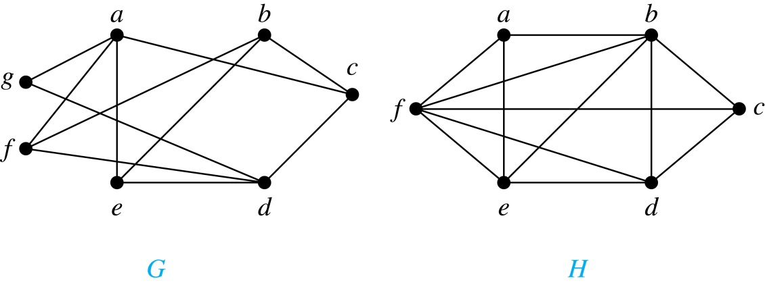
Bipartite Graphs
Definition: A simple graph G is bipartite if V can be partitioned into two disjoint subsets V₁ and V₂ such that every edge connects a vertex in V₁ and a vertex in V₂. In other words, there are no edges which connect two vertices in V₁ or in V₂.
It is not hard to show that an equivalent definition of a bipartite graph is a graph where it is possible to color the vertices red or blue so that no two adjacent vertices are the same color.
H is not bipartite
since if we color a red, then the adjacent vertices f and b must both be blue.
G is bipartite

Slide 23
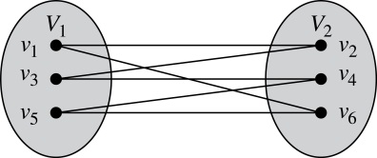
Bipartite Graphs (continued)
Example: Show that C₆ is bipartite.
Solution: We can partition the vertex set into V₁ = {v₁, v₃, v₅} and V₂ = {v₂, v₄, v₆} so that every edge of C₆ connects a vertex in V₁ and V₂ .
Example: Show that C₃ is not bipartite.
Solution: If we divide the vertex set of C₃ into two nonempty sets, one of the two must contain two vertices. But in C₃ every vertex is connected to every other vertex. Therefore, the two vertices in the same partition are connected. Hence, C₃ is not bipartite.

Slide 24
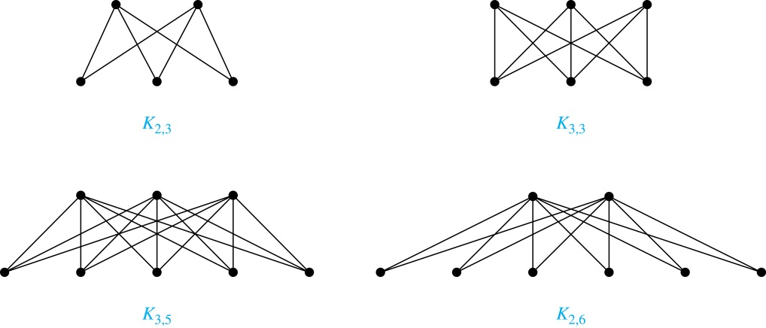
Complete Bipartite Graphs
Definition: A complete bipartite graph K_{m,n} is a graph that has its vertex set partitioned into two subsets V₁ of size m and V₂ of size n such that there is an edge from every vertex in V₁ to every vertex in V₂.
Example: We display four complete bipartite graphs here.

Slide 25
Bipartite Graphs and Matchings
Bipartite graphs are used to model applications that involve matching the elements of one set to elements in another, for example:
Job assignments - vertices represent the jobs and the employees, edges link employees with those jobs they have been trained to do. A common goal is to match jobs to employees so that the most jobs are done.
Marriage - vertices represent the men and the women and edges link a a man and a woman if they are an acceptable spouse. We may wish to find the largest number of possible marriages.

Slide 26
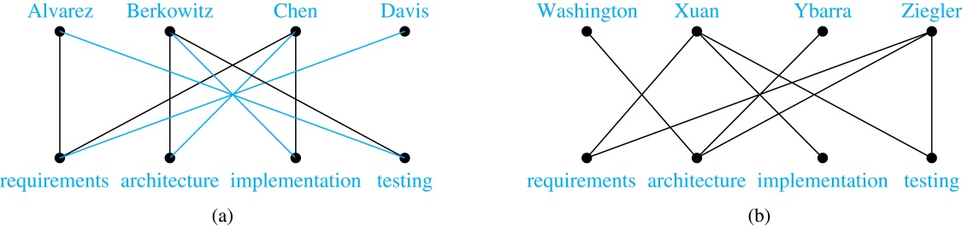

Slide 27
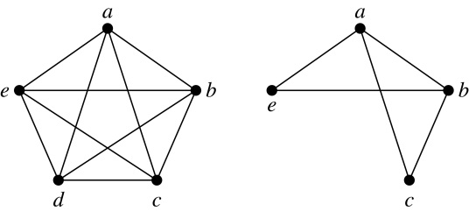
New Graphs from Old
Definition: A subgraph of a graph G = (V,E) is a graph (W,F), where W ⊂ V and F ⊂ E. A subgraph H of G is a proper subgraph of G if H ≠ G.
Example: Here we show K₅ and one of its subgraphs.
Definition: Let G = (V, E) be a simple graph. The subgraph induced by a subset W of the vertex set V is the graph (W,F), where the edge set F contains an edge in E if and only if both endpoints are in W.
Example: Here we show K₅ and the subgraph induced by W = {a,b,c,e}.

Slide 28
Isomorphism of Graphs
Definition: The simple graphs G₁ = (V₁, E₁) and G₂ = (V₂, E₂) are isomorphic if there is a one-to-one and onto function f from V₁ to V₂ with the property that a and b are adjacent in G₁ if and only if f(a) and f(b) are adjacent in G₂ , for all a and b in V₁ . Such a function f is called an isomorphism. Two simple graphs that are not isomorphic are called nonisomorphic.

Slide 29
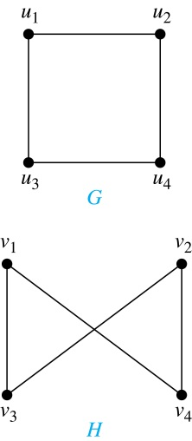
Isomorphism of Graphs (cont.)
Example: Show that the graphs G =(V, E) and H = (W, F) are isomorphic.
Solution: The function f with f(u₁) = v₁,
f(u₂) = v₄, f(u₃) = v₃, and f(u₄) = v₂ is a
one-to-one correspondence between V and W. Note that adjacent vertices in G are u₁ and u₂, u₁ and u₃, u₂ and u₄, and u₃ and u₄. Each of the pairs f(u₁) = v₁ and f(u₂) = v₄, f(u₁) = v₁ and f(u₃) = v₃ , f(u₂) = v₄ and f(u₄) = v₂ , and f(u₃) = v₃ and f(u₄) = v₂ consists of two adjacent vertices in H.

Slide 30
Isomorphism of Graphs (cont.)
It is difficult to determine whether two simple graphs are isomorphic using brute force because there are n! possible one-to-one correspondences between the vertex sets of two simple graphs with n vertices.
The best algorithms for determining weather two graphs are isomorphic have exponential worst case complexity in terms of the number of vertices of the graphs.
Sometimes it is not hard to show that two graphs are not isomorphic. We can do so by finding a property, preserved by isomorphism, that only one of the two graphs has. Such a property is called graph invariant.
There are many different useful graph invariants that can be used to distinguish nonisomorphic graphs, such as the number of vertices, number of edges, and degree sequence (list of the degrees of the vertices in nonincreasing order). We will encounter others in later sections of this chapter.

Slide 31
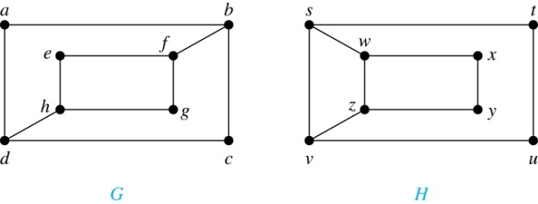
Isomorphism of Graphs (cont.)
Example: Determine whether these two graphs are isomorphic.
Solution: Both graphs have eight vertices and ten edges.
They also both have four vertices of degree two and four of degree three.
However, G and H are not isomorphic. Note that since deg(a) = 2 in G, a must correspond to t, u, x, or y in H, because these are the vertices of degree 2. But each of these vertices is adjacent to another vertex of degree two in H, which is not true for a in G.
.

Slide 32
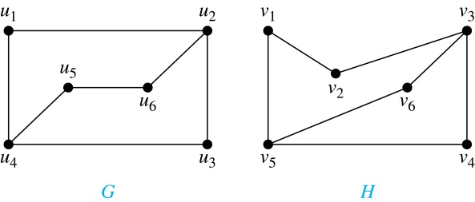
Isomorphism of Graphs (cont.)
Example: Determine whether these two graphs are isomorphic.
Solution: Both graphs have six vertices and seven edges.
They also both have four vertices of degree two and two of degree three.
The subgraphs of G and H consisting of all the vertices of degree two and the edges connecting them are isomorphic. So, it is reasonable to try to find an isomorphism f.
We define an injection f from the vertices of G to the vertices of H that preserves the degree of vertices. We will determine whether it is an isomorphism.
The function f with f(u₁) = v₆, f(u₂) = v₃, f(u₃) = v₄, and f(u₄) = v₅ , f(u₅) = v₁, and f(u₆) = v₂ is a one-to-one correspondence between G and H. Showing that this correspondence preserves edges is straightforward, so we will omit the details here. Because f is an isomorphism, it follows that G and H are isomorphic graphs.
See the text for an illustration of how adjacency matrices can be used for this verification.

Slide 33
Applications of Graph Isomorphism
The question whether graphs are isomorphic plays an important role in applications of graph theory. For example,
chemists use molecular graphs to model chemical compounds. Vertices represent atoms and edges represent chemical bonds. When a new compound is synthesized, a database of molecular graphs is checked to determine whether the graph representing the new compound is isomorphic to the graph of a compound that this already known.
Electronic circuits are modeled as graphs in which the vertices represent components and the edges represent connections between them. Graph isomorphism is the basis for
the verification that a particular layout of a circuit corresponds to the design’s original schematics.
determining whether a chip from one vendor includes the intellectual property of another vendor.

Slide 34
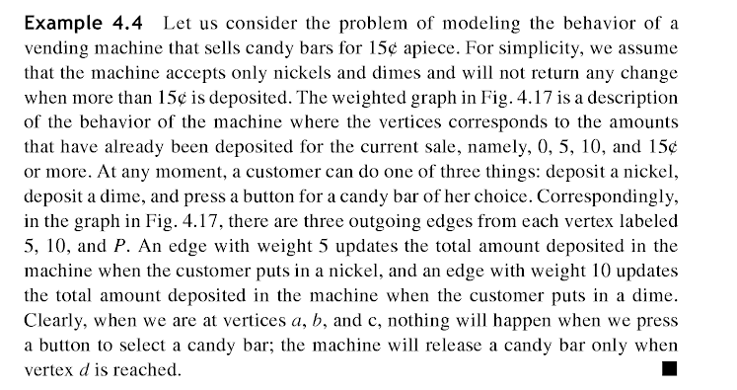
A sample problem

Slide 35
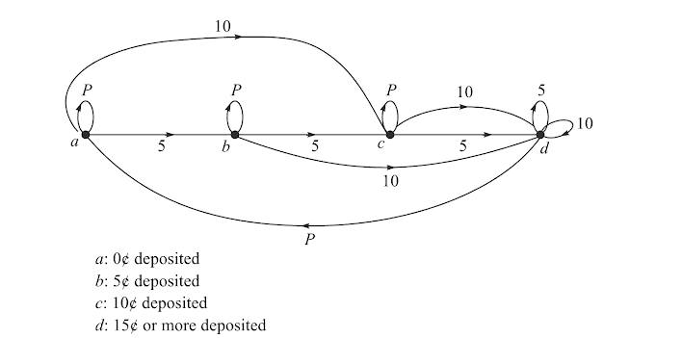
Solution

Slide 36
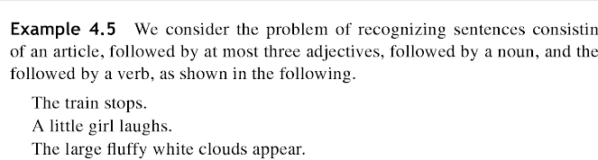
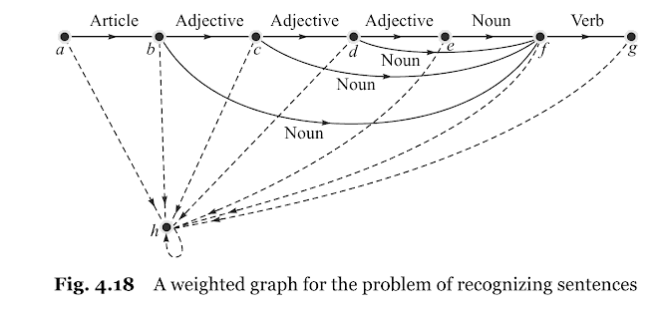
Another Problem

Slide 37
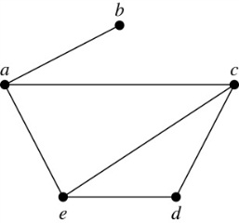
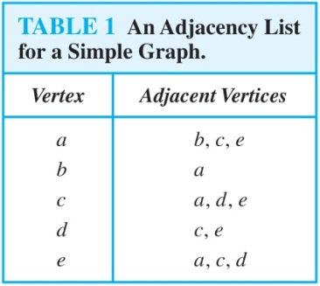
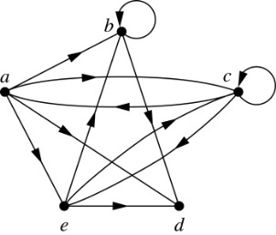
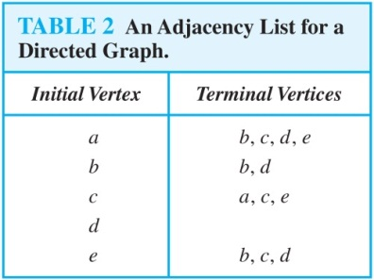
Representing Graphs: Adjacency Lists
Definition: An adjacency list can be used to represent a graph with no multiple edges by specifying the vertices that are adjacent to each vertex of the graph.
Example:
Example:

Slide 38
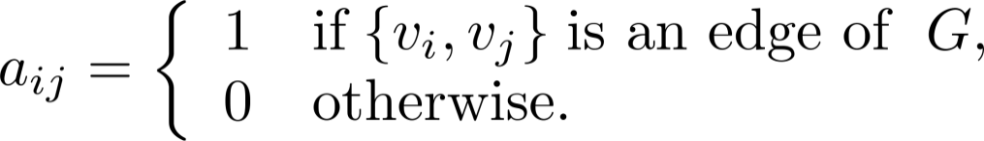
Representation of Graphs: Adjacency Matrices
Definition: Suppose that G = (V, E) is a simple graph where |V| = n. Arbitrarily list the vertices of G as v₁, v₂, … , v_{n}. The adjacency matrix A_{G} of G, with respect to the listing of vertices, is the n × n zero-one matrix with 1 as its (i, j)th entry when v_{i} and v_{j} are adjacent, and 0 as its (i, j)th entry when they are not adjacent.
In other words, if the graphs adjacency matrix is A_{G} = [a_{ij}], then

Slide 39
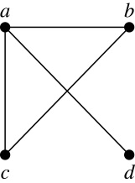
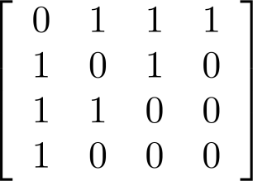
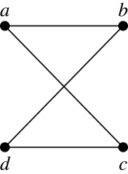
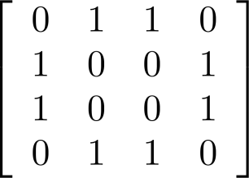
Adjacency Matrices (continued)
Example:
When a graph is sparse, that is, it has few edges relatively to the total number of possible edges, it is much more efficient to represent the graph using an adjacency list than an adjacency matrix. But for a dense graph, which includes a high percentage of possible edges, an adjacency matrix is preferable.
The ordering of
vertices is a, b, c, d.
The ordering of
vertices is a, b, c, d.
Note: The adjacency matrix of a simple graph is symmetric, i.e., a_{ij} = a_{ji}
Also, since there are no loops, each diagonal entry a_{ij} for i = 1, 2, 3, …, n, is 0.

Slide 40
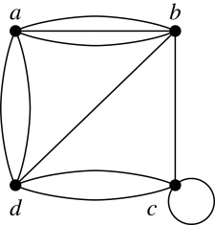
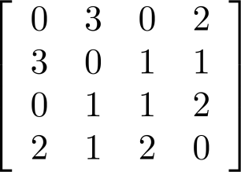
Adjacency Matrices (continued)
Adjacency matrices can also be used to represent graphs with loops and multiple edges.
A loop at the vertex v_{i} is represented by a 1 at the (i, j)th position of the matrix.
When multiple edges connect the same pair of vertices v_{i} and v_{j}, (or if multiple loops are present at the same vertex), the (i, j)th entry equals the number of edges connecting the pair of vertices.
Example: We give the adjacency matrix of the pseudograph shown here using the ordering of vertices a, b, c, d.

Slide 41
Adjacency Matrices (continued)
Adjacency matrices can also be used to represent directed graphs. The matrix for a directed graph G = (V, E) has a 1 in its (i, j)th position if there is an edge from v_{i} to v_{j}, where v₁, v₂, … v_{n} is a list of the vertices.
In other words, if the graphs adjacency matrix is A_{G} = [a_{ij}], then
The adjacency matrix for a directed graph does not have to be symmetric, because there may not be an edge from v_{i} to v_{j}, when there is an edge from v_{j} to v_{i}.
To represent directed multigraphs, the value of a_{ij} is the number of edges connecting v_{i} to v_{j}.

Slide 42
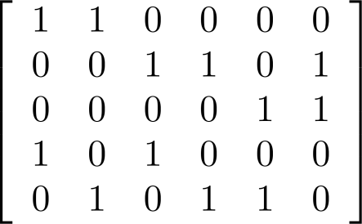
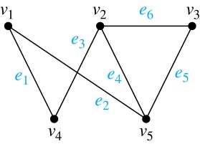
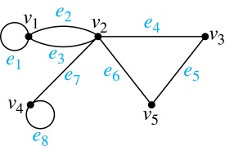
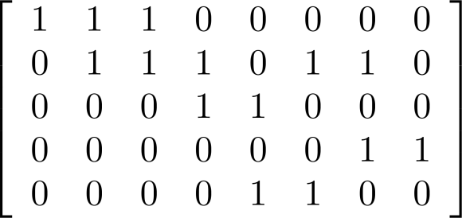
Incidence Matrices (continued)
Example: Simple Graph and Incidence Matrix
The rows going from top to bottom represent v₁ through v₅ and the columns going from left to right represent e₁ through e₆.
Example: Pseudograph and Incidence Matrix
The rows going from top to bottom represent v₁ through v₅ and the columns going from left to right represent e₁ through e₈.

Slide 43
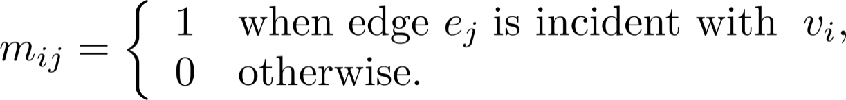
Representation of Graphs: Incidence Matrices
Definition: Let G = (V, E) be an undirected graph with vertices where v₁, v₂, … v_{n} and edges e₁, e₂, … e_{m}. The incidence matrix with respect to the ordering of V and E is the n × m matrix M = [m_{ij}], where

Slide 44
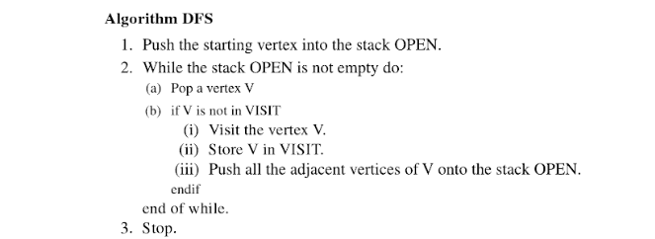
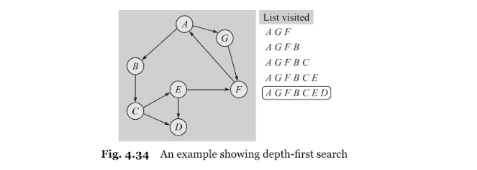
Graph Traversals-Depth First Search

Slide 45
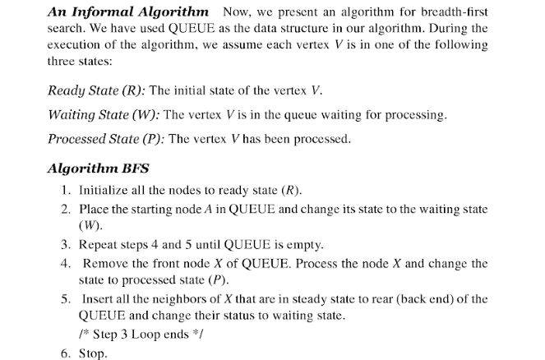
Graph Traversals-Breadth First Search

Slide 46
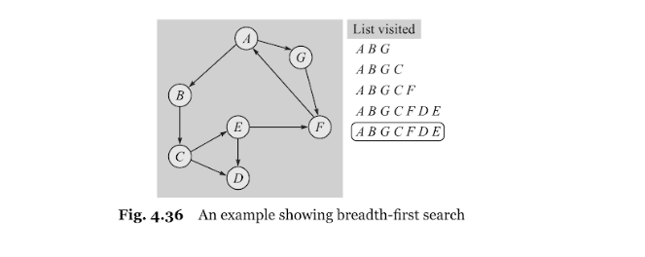
Example of BFS

Slide 47
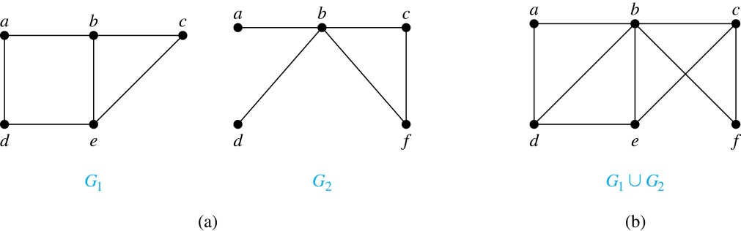
New Graphs from Old (continued)
Definition: The union of two simple graphs G₁ = (V₁, E₁) and G₂ = (V₂, E₂) is the simple graph with vertex set V₁ ⋃ V₂ and edge set E₁ ⋃ E₂. The union of G₁ and G₂ is denoted by G₁ ⋃ G₂.
Example:

Slide 48
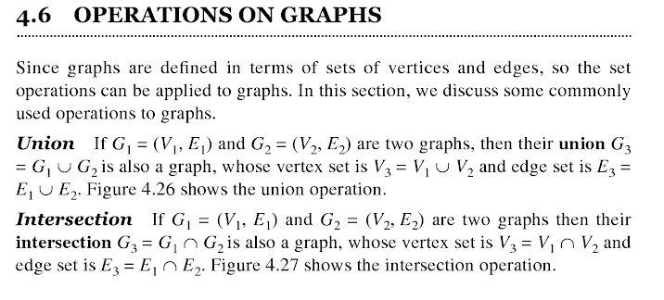
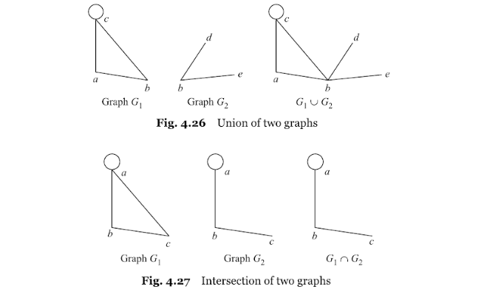

Slide 49

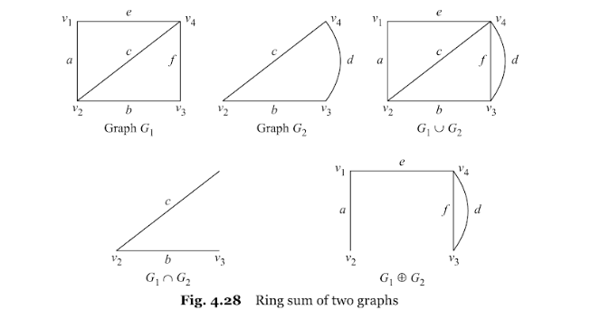

Slide 50




Slide 51


Slide 52
Paths and Circuits
Informal Definition: A path is a sequence of edges that begins at a vertex of a graph and travels from vertex to vertex along edges of the graph. As the path travels along its edges, it visits the vertices along this path, that is, the endpoints of these.
Applications: Numerous problems can be modeled with paths formed by traveling along edges of graphs such as:
determining whether a message can be sent between two computers.
efficiently planning routes for mail delivery.

Slide 53
Paths
Definition: Let n be a nonnegative integer and G an undirected graph. A path of length n from u to v in G is a sequence of n edges e₁, … , e_{n} of G for which there exists a sequence x₀ = u, x₁, …, x_{n-1}, x_{n} = v of vertices such that e_{i} has, for i = 1, …, n, the endpoints x_{i-1} and x_{i}.
When the graph is simple, we denote this path by its vertex sequence x₀, x₁, … , x_{n}(since listing the vertices uniquely determines the path).
The path is a circuit if it begins and ends at the same vertex (u = v) and has length greater than zero.
The path or circuit is said to pass through the vertices x₁, x₂, … , x_{n-1} and traverse the edges e₁, … , e_{n}.
A path or circuit is simple if it does not contain the same edge more than once.
This terminology is readily extended to directed graphs. (see text)

Slide 54

Paths (continued)
Example: In the simple graph here:
a, d, c, f, e is a simple path of length 4.
d, e, c, a is not a path because e is not connected to c.
b, c, f, e, b is a circuit of length 4.
a, b, e, d, a, b is a path of length 5, but it is not a simple path.

Slide 55

Connectedness in Undirected Graphs
Definition: An undirected graph is called connected if there is a path between every pair of vertices. An undirected graph that is not connected is called disconnected. We say that we disconnect a graph when we remove vertices or edges, or both, to produce a disconnected subgraph.
Example: G₁ is connected because there is a path between any pair of its vertices, as can be easily seen. However G₂ is not connected because there is no path between vertices a and f, for example.

Slide 56

Connected Components
Definition: A connected component of a graph G is a connected subgraph of G that is not a proper subgraph of another connected subgraph of G. A graph G that is not connected has two or more connected components that are disjoint and have G as their union.
Example: The graph H is the union of three disjoint subgraphs H₁, H₂, and H₃, none of which are proper subgraphs of a larger connected subgraph of G.These three subgraphs are the connected components of H.

Slide 57
Connectedness in Directed Graphs
Definition: A directed graph is strongly connected if there is a path from a to b and a path from b to a whenever a and b are vertices in the graph.
Definition: A directed graph is weakly connected if there is a path between every two vertices in the underlying undirected graph, which is the undirected graph obtained by ignoring the directions of the edges of the directed graph.

Slide 58

Connectedness in Directed Graphs (continued)
Example: G is strongly connected because there is a path between any two vertices in the directed graph. Hence, G is also weakly connected. The graph H is not strongly connected, since there is no directed path from a to b, but it is weakly connected.
Definition: The subgraphs of a directed graph G that are strongly connected but not contained in larger strongly connected subgraphs, that is, the maximal strongly connected subgraphs, are called the strongly connected components or strong components of G.
Example (continued): The graph H has three strongly connected components, consisting of the vertex a; the vertex e; and the subgraph consisting of the vertices b, c, d and edges (b,c), (c,d), and (d,b).

Slide 59


Counting Paths between Vertices (continued)
Example: How many paths of length four are there from a to d in the graph G.
Solution: The adjacency matrix of G (ordering the vertices as a, b, c, d) is given above. Hence the number of paths of length four from a to d is the (1, 4)th entry of A⁴ . The eight paths are as:
adjacency matrix of G
G
A =
A⁴ =
a, b, a, b, d a, b, a, c, d
a, b, d, b, d a, b, d, c, d
a, c, a, b, d a, c, a, c, d
a, c, d, b, d a, c, d, c, d

Slide 60


Shortest Path in Weighted Graphs- Dijkstra Algorithm

Slide 61


Shortest Path in Weighted Graphs- Dijkstra Algorithm

Slide 62


Shortest Path in Weighted Graphs- Dijkstra Algorithm

Slide 63


Euler Paths and Circuits
The town of Kӧnigsberg, Prussia (now Kalingrad, Russia) was divided into four sections by the branches of the Pregel river. In the 18th century seven bridges connected these regions.
People wondered whether it was possible to follow a path that crosses each bridge exactly once and returns to the starting point.
The Swiss mathematician Leonard Euler proved that no such path exists. This result is often considered to be the first theorem ever proved in graph theory.
Multigraph Model of the Bridges of Kӧnigsberg
The 7 Bridges of Kӧnigsberg

Slide 64

Euler Paths and Circuits (continued)
Definition: An Euler circuit in a graph G is a simple circuit containing every edge of G. An Euler path in G is a simple path containing every edge of G.
Example: Which of the undirected graphs G₁, G₂, and G₃ has a Euler circuit? Of those that do not, which has an Euler path?
Solution: The graph G₁ has an Euler circuit (e.g., a, e, c, d, e, b, a). But, as can easily be verified by inspection, neither G₂ nor G₃ has an Euler circuit. Note that G₃ has an Euler path (e.g., a, c, d, e, b, d, a, b), but there is no Euler path in G₂, which can be verified by inspection.

Slide 65
Necessary Conditions for Euler Circuits and Paths
An Euler circuit begins with a vertex a and continues with an edge incident with a, say {a, b}. The edge {a, b} contributes one to deg(a).
Each time the circuit passes through a vertex it contributes two to the vertex’s degree.
Finally, the circuit terminates where it started, contributing one to deg(a). Therefore deg(a) must be even.
We conclude that the degree of every other vertex must also be even.
By the same reasoning, we see that the initial vertex and the final vertex of an Euler path have odd degree, while every other vertex has even degree. So, a graph with an Euler path has exactly two vertices of odd degree.
In the next slide we will show that these necessary conditions are also sufficient conditions.

Slide 66

Sufficient Conditions for Euler Circuits and Paths
Suppose that G is a connected multigraph with ≥ 2 vertices, all of even degree. Let x₀ = a be a vertex of even degree. Choose an edge {x₀, x₁} incident with a and proceed to build a simple path {x₀, x₁}, {x₁, x₂}, …, {x_{n-1}, x_{n}} by adding edges one by one until another edge can not be added.
The path begins at a with an edge of the form {a, x}; we show that it must terminate at a with an edge of the form {y, a}. Since each vertex has an even degree, there must be an even number of edges incident with this vertex. Hence, every time we enter a vertex other than a, we can leave it. Therefore, the path can only end at a.
If all of the edges have been used, an Euler circuit has been constructed. Otherwise, consider the subgraph H obtained from G by deleting the edges already used.
We illustrate this idea in the graph G here. We begin at a and choose the edges {a, f}, {f, c}, {c, b}, and {b, a} in succession.
In the example H consists of the vertices c, d, e.

Slide 67
Sufficient Conditions for Euler Circuits and Paths (continued)
Because G is connected, H must have at least one vertex in common with the circuit that has been deleted.
Every vertex in H must have even degree because all the vertices in G have even degree and for each vertex, pairs of edges incident with this vertex have been deleted. Beginning with the shared vertex construct a path ending in the same vertex (as was done before). Then splice this new circuit into the original circuit.
Continue this process until all edges have been used. This produces an Euler circuit. Since every edge is included and no edge is included more than once.
Similar reasoning can be used to show that a graph with exactly two vertices of odd degree must have an Euler path connecting these two vertices of odd degree
In the example, the vertex is c.
In the example, we end up with the circuit a, f, c, d, e, c, b, a.

Slide 68
Necessary and Sufficient Conditions for Euler Circuits and Paths (continued)
Theorem: A connected multigraph with at least two vertices has an Euler circuit if and only if each of its vertices has an even degree and it has an Euler path if and only if it has exactly two vertices of odd degree.
Example: Two of the vertices in the multigraph model of the Kӧnigsberg bridge problem have odd degree. Hence, there is no Euler circuit in this multigraph and it is impossible to start at a given point, cross each bridge exactly once, and return to the starting point.

Slide 69

Euler Circuits and Paths
Example:
G₁ contains exactly two vertices of odd degree (b and d). Hence it has an Euler path, e.g., d, a, b, c, d, b.
G₂ has exactly two vertices of odd degree (b and d). Hence it has an Euler path, e.g., b, a, g, f, e, d, c, g, b, c, f, d.
G₃ has six vertices of odd degree. Hence, it does not have an Euler path.

Slide 70
Applications of Euler Paths and Circuits
Euler paths and circuits can be used to solve many practical problems such as finding a path or circuit that traverses each
street in a neighborhood,
road in a transportation network,
connection in a utility grid,
link in a communications network.
Other applications are found in the
layout of circuits,
network multicasting,
molecular biology, where Euler paths are used in the sequencing of DNA.

Slide 71



Hamilton Paths and Circuits
William Rowan Hamilton (1805- 1865)
Euler paths and circuits contained every edge only once. Now we look at paths and circuits that contain every vertex exactly once.
William Hamilton invented the Icosian puzzle in 1857. It consisted of a wooden dodecahedron (with 12 regular pentagons as faces), illustrated in (a), with a peg at each vertex, labeled with the names of different cities. String was used to plot a circuit visiting 20 cities exactly once.
The graph form of the puzzle is given in (b).
The solution (a Hamilton circuit) is given here.

Slide 72
Hamilton Paths and Circuits
Definition: A simple path in a graph G that passes through every vertex exactly once is called a Hamilton path, and a simple circuit in a graph G that passes through every vertex exactly once is called a Hamilton circuit.
That is, a simple path x₀, x₁, …, x_{n-1}, x_{n} in the graph G = (V, E) is called a Hamilton path if V = {x₀, x₁, … , x_{n-1,} x_{n} } and x_{i} ≠ x_{j} for 0≤ i < j ≤ n, and the simple circuit x₀, x₁, …, x_{n-1}, x_{n}, x₀ (with n > 0) is a Hamilton circuit if x₀, x₁, … , x_{n-1}, x_{n} is a Hamilton path.

Slide 73
Hamilton Paths and Circuits (continued)
Example: Which of these simple graphs has a Hamilton circuit or, if not, a Hamilton path?
Solution: G₁ has a Hamilton circuit: a, b, c, d, e, a.
G₂ does not have a Hamilton circuit (Why?), but does have a Hamilton path : a, b, c, d.
G₃ does not have a Hamilton circuit, or a Hamilton path. Why?

Slide 74


Necessary Conditions for Hamilton Circuits
Gabriel Andrew Dirac
(1925-1984)
Unlike for an Euler circuit, no simple necessary and sufficient conditions are known for the existence of a Hamiton circuit.
However, there are some useful necessary conditions. We describe two of these now.
Dirac’s Theorem: If G is a simple graph with n ≥ 3 vertices such that the degree of every vertex in G is ≥ n/2, then G has a Hamilton circuit.
Ore’s Theorem: If G is a simple graph with n ≥ 3 vertices such that deg(u) + deg(v) ≥ n for every pair of nonadjacent vertices, then G has a Hamilton circuit.
Øysten Ore
(1899-1968)

Slide 75
Applications of Hamilton Paths and Circuits
Applications that ask for a path or a circuit that visits each intersection of a city, each place pipelines intersect in a utility grid, or each node in a communications network exactly once, can be solved by finding a Hamilton path in the appropriate graph.
The famous traveling salesperson problem (TSP) asks for the shortest route a traveling salesperson should take to visit a set of cities. This problem reduces to finding a Hamilton circuit such that the total sum of the weights of its edges is as small as possible.
A family of binary codes, known as Gray codes, which minimize the effect of transmission errors, correspond to Hamilton circuits in the n-cube Q_{n}. (See the text for details.)

Slide 76



Travelling Salesman Problem-Nearest Neighbor Method

Slide 77

Travelling Salesman Problem-Nearest Neighbor Method

Slide 78

Travelling Salesman Problem-Nearest Neighbor Method

Slide 79

Travelling Salesman Problem-Nearest Neighbor Method

Slide 80

Planar Graphs
Which are planar and which are not planar??

Slide 81

Planar Graphs

Slide 82

Planar Graphs

Slide 83

Corollary 1
Prove K5 is non planar

Slide 84


Corollary 2

Slide 85

Examples

Slide 86

Kuratwoski’s Theorm

